Slide 1

developed by Team JavaLamps
Qingyue (Kathryn) Li, Elly Meng, Rae Lee, Chun-hung (John) Lin

Slide 2

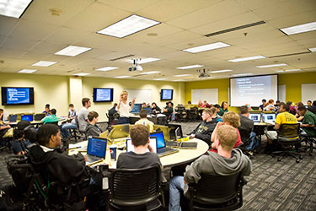
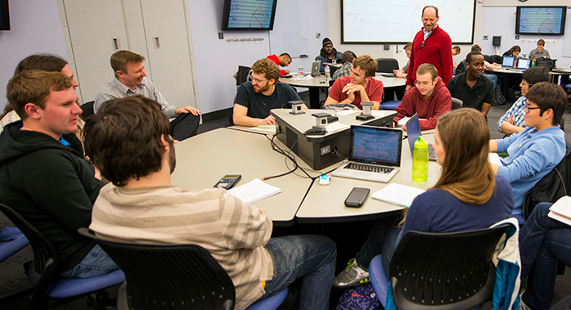
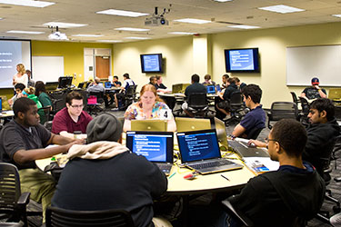

Slide 3


All Bachelor’s Degrees
Source: National Center for Education Statistics

Slide 4
STEM Degrees
Source: National Center for Education Statistics

Slide 5
Computer Science Degrees
Source: National Center for Education Statistics

Slide 9
Support.

Slide 10
Support. Mentorship.

Slide 11
Support. Mentorship. Community.

Slide 12
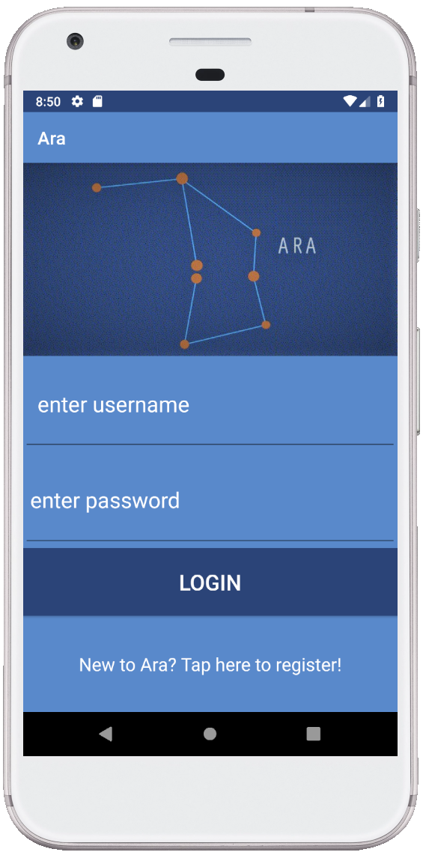
Developed for Android

Slide 13
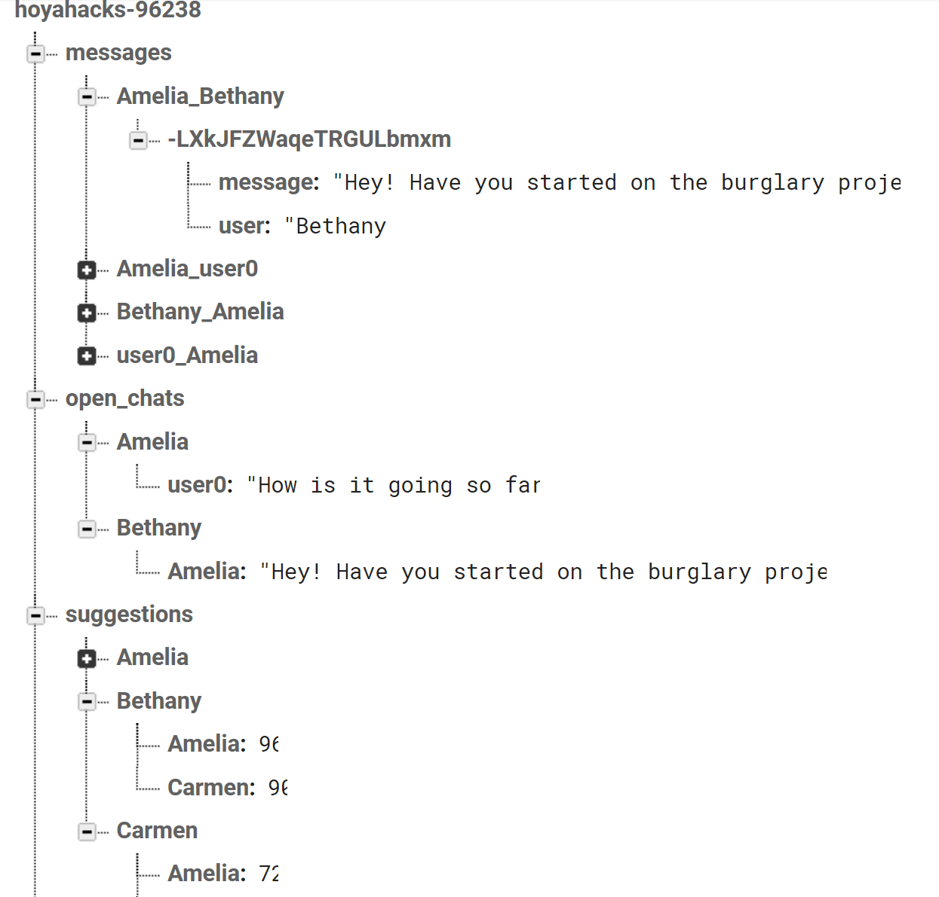
Powered by Google Firebase

